Slide 1
Human Pose Estimation Assignment 2020 Computer Vision
Name : Satyajit Ghana
USN : 17ETCS002159
Course Code : CSE308A
Department : Computer Science

Slide 2
Introduction to HPE

Slide 3
Refers to the task of recognizing the human body landmarks (Head, Shoulder, Wrist, Hip, Knee, Ankle) from a single monocular image.

Slide 4
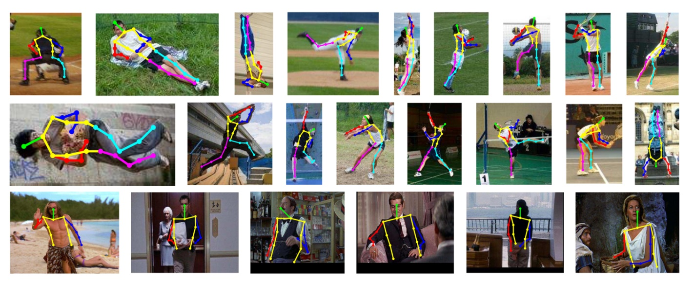

Slide 5
But what are its Applications?

Slide 6
Activity Recognition
Human Tracking
Movies and Animation Sequencing
Virtual Reality
Human-Computer Interaction
Medical Surgery Assistance
Military Training Assistant
Self-Driving Cars
Motion Analysis
*Basically a precursor to most computer vision tasks

Slide 7
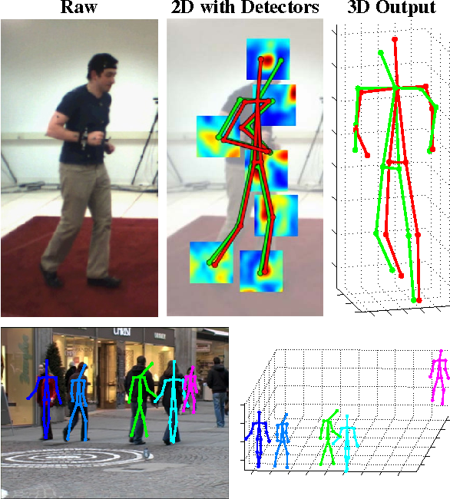

Slide 8
Challenges in HPE

Slide 9
Flexible body configuration indicates complex independent joints and degree-of-freedom limbs, which may cause self-occlusion or rare-complex poses
Diverse body appearance includes different clothing and self-similar parts
Complex environment may cause foreground occlusion or similar parts from nearby persons, various viewing angles, and truncation in the camera view

Slide 10
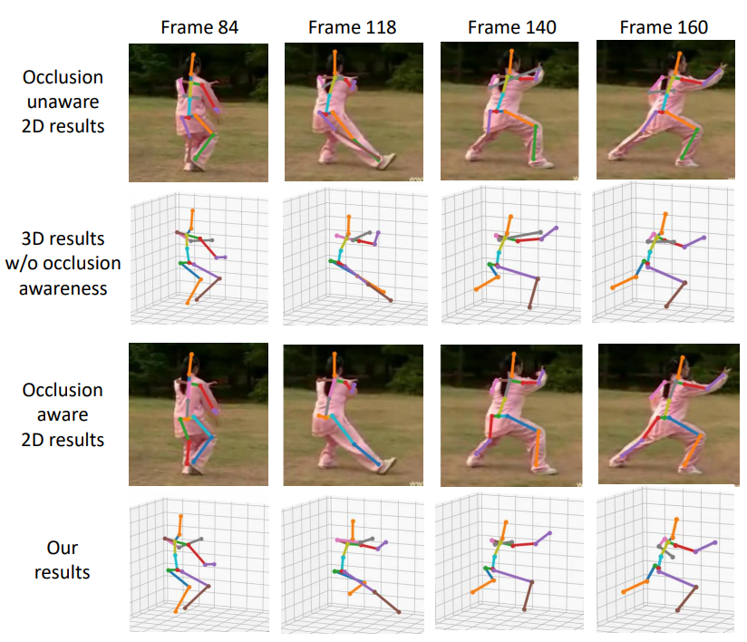

Slide 11
Methods for HPE

Slide 12
Generative vs Discriminative
Top-Down vs Bottom-Up
Regression vs Detection
One-Stage vs Multi-Stage

Slide 13
Dataset

Slide 14
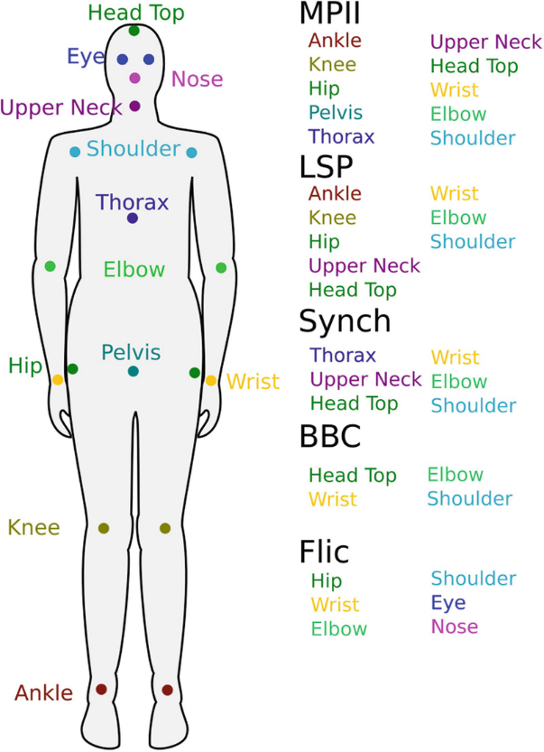
MPII is the state-of-the-art benchmark for evaluation of articulated human pose estimation.
The dataset includes 25K images containing over 40K people with annotated body joints.
Each image was extracted from a YouTube video and provided with preceding and annotated frames

Slide 15
Comparison of SOTA Models

Slide 16
Methods | Backbone | Input size | Highlights | PCKh (%)
Regression-based
(Toshev and Szegedy, 2014) | AlexNet | 220×220 | Direct regression, multi-stage refinement | -
(Carreira et al., 2016) | GoogleNet | 224×224 | Iterative error feedback refinement from initial pose. | 81.3
(Sun et al., 2017) | ResNet-50 | 224×224 | Bone based representation as additional constraint, general for both 2D/3D HPE | 86.4
(Luvizon et al., 2017) | Inception-v4+ Hourglass | 256×256 | Multi-stage architecture, proposed soft-argmax function to convert heatmaps into joint locations | 91.2

Slide 17
Detection-based
(Tompson et al., 2014) | AlexNet | 320×240 | Heatmap representation, multi-scale input, MRF-like Spatial-Model | 79.6
(Yang et al., 2016) | VGG | 112×112 | Jointly learning DCNNs with deformable mixture of parts models | -
(Newell et al., 2016) | Hourglass | 256×256 | Proposed stacked Hourglass architecture with intermediate supervision. | 90.9
(Wei et al., 2016) | CPM | 368×368 | Proposed Convolutional Pose Machines (CPM) with intermediate input and supervision, learn spatial correlations among body parts | 88.5
(Chu et al., 2017) | Hourglass | 256×256 | Multi-resolution attention maps from multi-scale features, proposed micro hourglass residual units to increase the receptive field | 91.5
(Yang et al., 2017) | Hourglass | 256×256 | Proposed Pyramid Residual Module (PRM) learns filters for input features with different resolutions | 92.0
(Chen et al., 2017) | conv-deconv | 256×256 | GAN, stacked conv-deconv architecture, multi-task for pose and occlusion, two discriminators for distinguishing whether the pose is ’real’ and the confidence is strong | 91.9
(Peng et al., 2018) | Hourglass | 256×256 | GAN, proposed augmentation network to generate data augmentations without looking for more data | 91.5
(Ke et al., 2018) | Hourglass | 256×256 | Improved Hourglass network with multi-scale intermediate supervision, multi-scale feature combination, structure-aware loss and data augmentation of joints masking | 92.1
(Tang et al., 2018a) | Hourglass | 256×256 | Compositional model, hierarchical representation of body parts for intermediate supervision | 92.3
(Sun et al., 2019) | HRNet | 256×256 | high-resolution representations of features across the whole network, multi-scale fusion. | 92.3
(Tang and Wu, 2019) | Hourglass | 256×256 | data-driven joint grouping, proposed part-based branching network (PBN) to learn representations specific to each part group. | 92.7
(Zhihui et.al, 2019) | Hourglass-Multistage | 256x256 | Cascaded ResNet-50 and ResNet-101, and multi stage network | 93.9
(Bruno and Andreas, 2020) | Hourglass | 256x256 | WASP Module, LSTM like architecture for videos | 92.7
(Adrian et al, 2020) | Hourglass | 256x256 | Toward fast and accurate human pose estimation via soft-gated skip connections | 94.1

Slide 18
So what are the trends ?
There are lot more Detection-based models than Regression based models.
Accuracy of Detection based models is way more that Regression based.
Hourglass models are heavily used
ResNet is preferred as the backbone architecture for most of the models
Notes:
For the sake of simplicity we’ll only look into Detection and Regression based models, there are many other methods as we discussed before

Slide 19
Why are Detection models more popular?
Direct regression learning of only one single point is a difficulty since it is a highly nonlinear problem and lacks robustness.
Toshev and Szegedy (2014) firstly attempted to train an AlexNet-like network to learn join coordinated from full images in a straightforward manner without using any body model or part detectors.

Slide 20
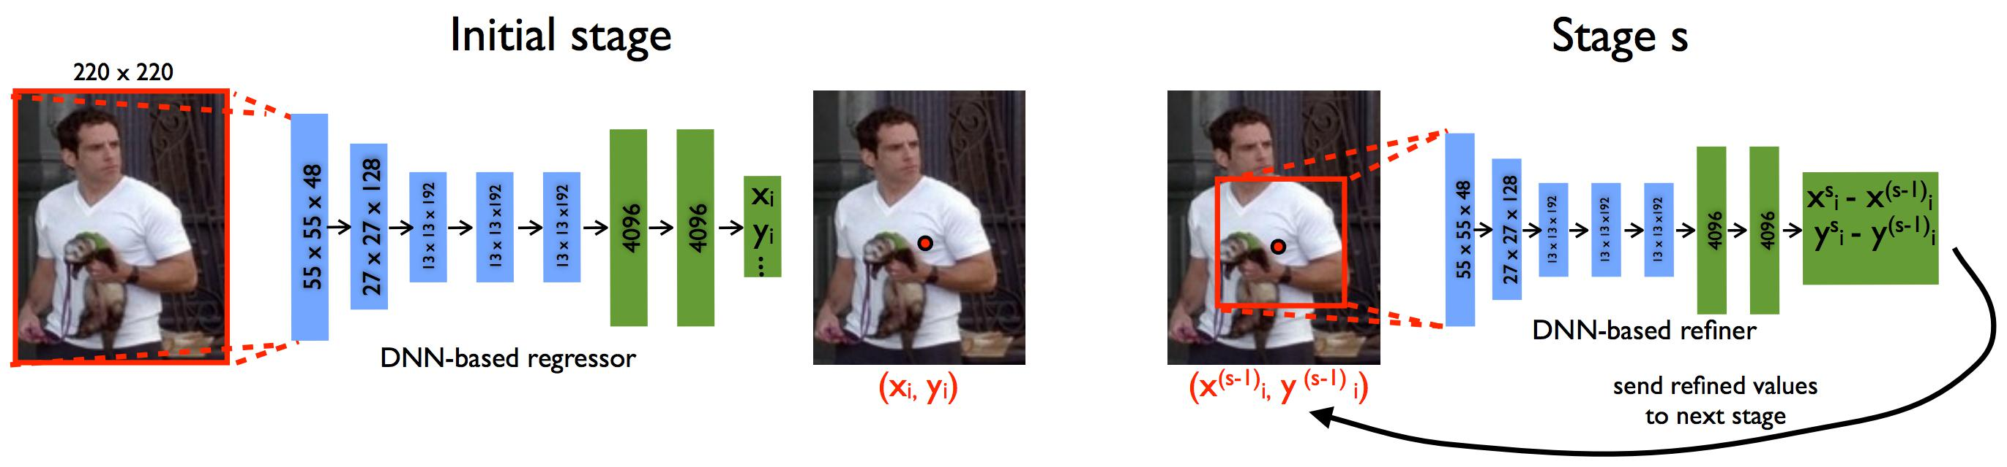
DeepPose Framework

Slide 21
Gkioxari et al. (2014) used a R-CNN architecture to detect a person, estimate pose, and classify action.
Each of the joint is shown in a 2D Gaussian distribution centered at the target joint location. Since heatmap representation is more robust than coordinate representation, most of the recent research is based on heatmap representation
Notes:
Detection is like a conv layer is responsible to predict an exact number where the joint will be, while in heatmap representation, each of the conv layer is responsible to predict a probability of the joint in the image frame.

Slide 22
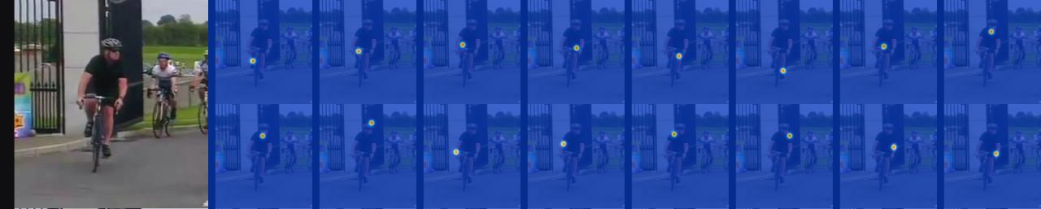

Slide 23
Why are HourGlass and ResNet popular?
First and foremost, they are SIMPLE !
Do not have vanishing gradient problem or gradient explosion problem
Skip Connections preserve a lot of information !
They make use of the input much better than other networks

Slide 24
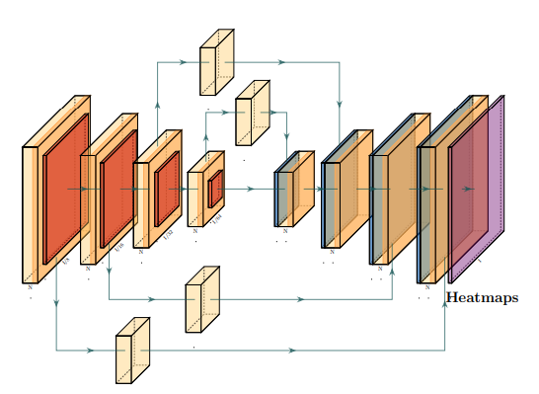
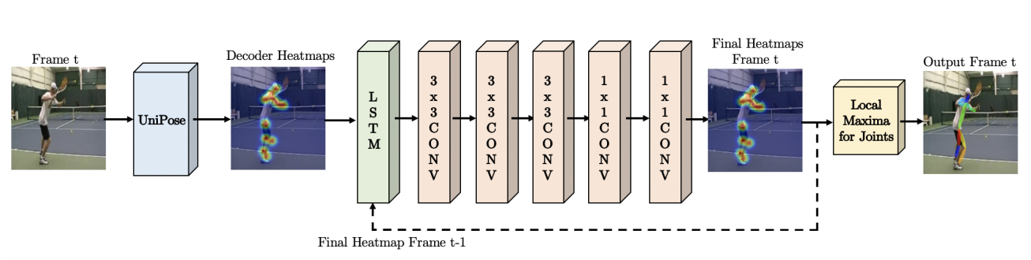
An HourGlass-ResNet Model
Unipose LSTM based model for pose estimation in videos

Slide 25
Evaluation Metric

Slide 26
PCK (Percentage of Correct Keypoints)
A candidate body joint is considered as correct if it falls within the threshold pixels of the ground-truth joint.
The threshold can be a fraction of the person bounding box size, pixel radius
50% of the head segment length of each test image (denoted as PCKh@0.5)

Slide 27
Example !

Slide 28
Simple Baselines for HPE – Microsoft Research
Proposed a simple model, i.e. a DeConv Head Attached to a ResNet backbone
This architecture is arguably the simples to generate heatmaps from deep and low-resolution features and also adopted in SOTA Mask R-CNN

Slide 29
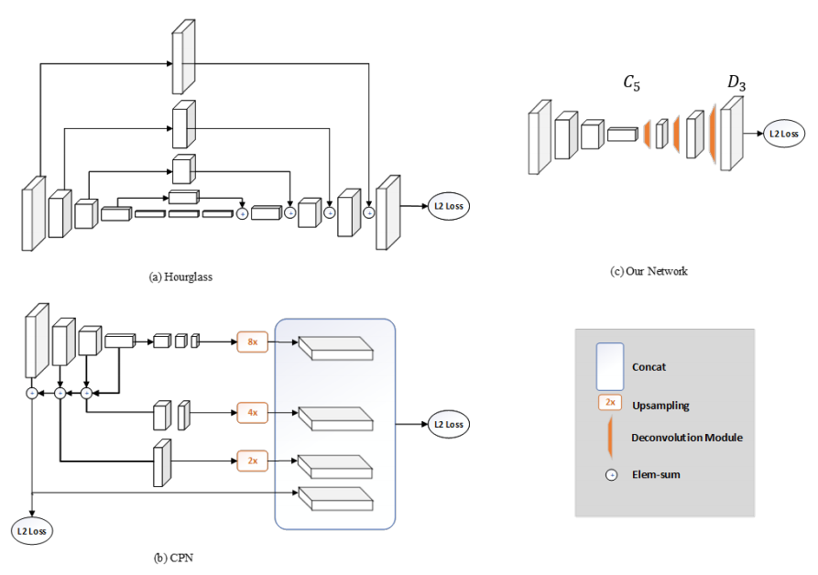

Slide 30

Input Image

Slide 31
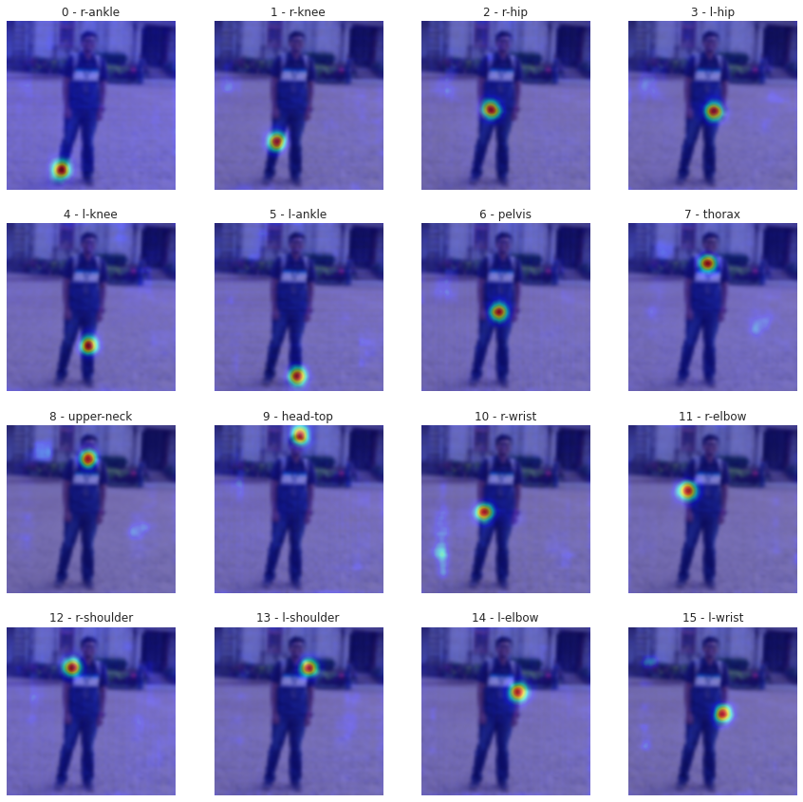
Joints HeatMaps

Slide 32
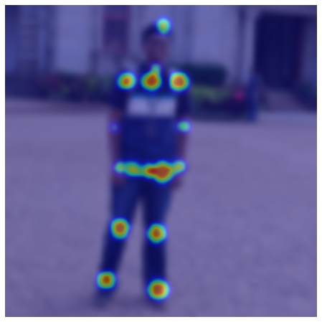
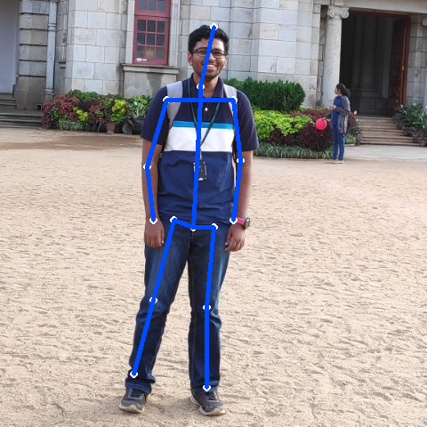
Estimated Pose

Slide 33
Demo !

Slide 34
https://tensorclan.tech/human-pose-estimation

Slide 35
References
Bulat, A., Kossaifi, J., Tzimiropoulos, G. and Pantic, M., 2020. Toward fast and accurate human pose estimation via soft-gated skip connections. arXiv preprint arXiv:2002.11098.
Chen, Y., Tian, Y. and He, M., 2020. Monocular human pose estimation: A survey of deep learning-based methods. Computer Vision and Image Understanding, 192, p.102897.
Sigal L. (2014) Human Pose Estimation. In: Ikeuchi K. (eds) Computer Vision. Springer, Boston, MA. https://doi.org/10.1007/978-0-387-31439-6_584
Satyajit G., 2020. Human Pose Estimation and Quantization of PyTorch to ONNX Models - A Detailed Guide. Satyajit Ghana. Available at: https://satyajit.tensorclan.tech/2020/08/pose-estimation-onnx.html [Accessed December 1, 2020].
Xiao, B., Wu, H. and Wei, Y., 2018. Simple baselines for human pose estimation and tracking. In Proceedings of the European conference on computer vision (ECCV) (pp. 466-481).

Slide 36
Thank You

